Slide 1


Accounting Essentials for Business Owners
Pam Duxbury FCA

Slide 2

What we will cover
  Why We Need Accounts
  Understanding Profit & Loss, EBITDA, and the Balance Sheet
  Cashflow Forecasting
  Finance Toolkit

Slide 3
Why We Need Accounts
•Statutory
•Companies House –Limited companies •HMRC –to calculate profit and taxes
•Where you stand financially •How well you are performing •How money flows through your business

Slide 4
Why We Need Accounts
Legal and practical requirements
• • • • •
Track performance over time Secure loans or investments Plan for taxes
Identify trends and opportunities
Make strategic decisions

Slide 5

Sales
£2,500
Rent
Wages
Supplies
Total Costs
£ 750
£1,000
£1,250
£3,000
Profit & Loss Account – Sarah’s Coffee Shop
Loss
£ 500

Slide 6
Understanding Profit and Loss, EBITDA and the Balance Sheet
Profit and Loss accounts tell us
  The profit or loss for a 12 month period only
  Categorised between Sales, costs of sales and expenses, interest and taxes, calculating the net profit
  Resets to £0 on the 1stday of the new year
  Give us a comparison to previous years – identify trends and variances

Slide 7
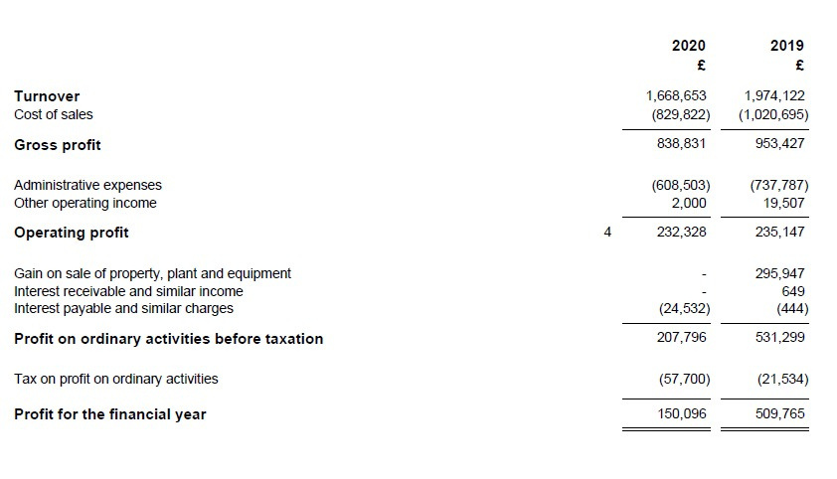
Profit & Loss Account – Income Statement

Slide 8
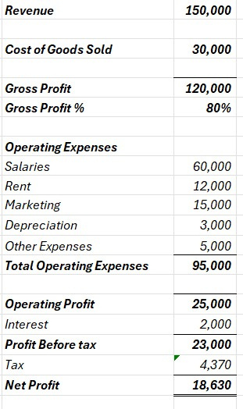
Profit & Loss Account – TechstartLtd

Slide 9
EBITDA
What is EBITDA? •Earnings Before Interest, Taxes, Depreciation and
Amortisation
•Compares companies regardless of debt levels (i.e. ignores
financing decisions –interest)
•Commonly used
•Used for valuation purposes

Slide 10
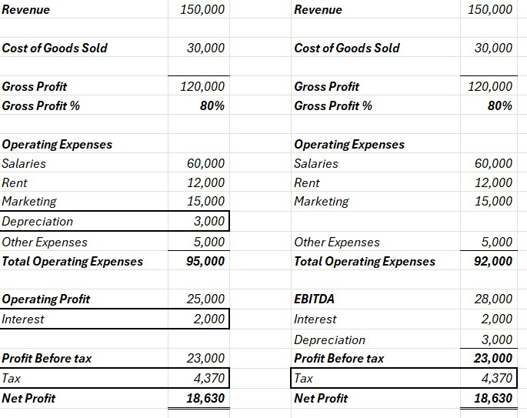
EBITDA – TechstartLtd

Slide 11
Understanding Profit and Loss, EBITDA and the Balance Sheet
The Balance Sheet tells us
  What we own and have earned cumulatively
  Categorised between Fixed assets, current assets, current liabilities, long term liabilities and equity
  Is the continuum of the business
  Is of interest to lenders
  Give us a comparison to previous years –identify trends and variances

Slide 12
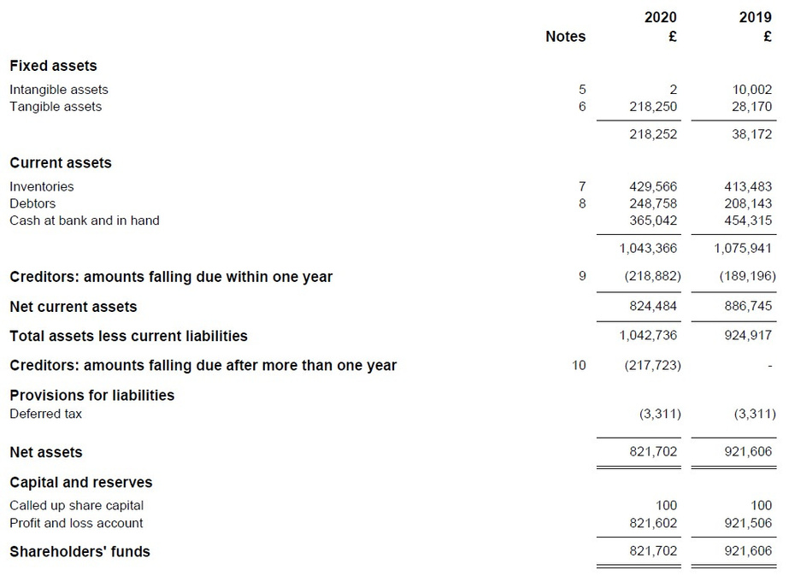
Balance Sheet

Slide 13
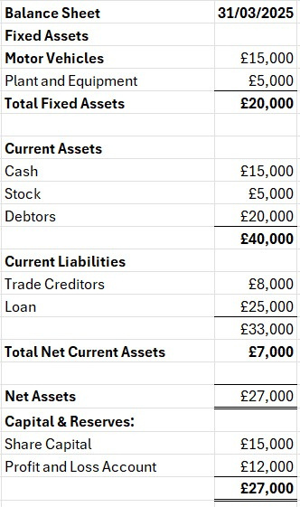
Balance Sheet – TechstartLtd

Slide 14
Cashflow -Cash vs Profit
Profit is an accounting view: Accrual view
Salemade butcustomermaynothave paid
Expenses
Cash is real life
Cash in: customer has paid
Cash out: you have paid supplier

Slide 15


Cashflow
  Cashflow is the movement in and out of money within the business
  Operating Cashflow – customers, suppliers, payroll, admin expenses
  Investing Cashflow –Equipment, property
  Financing Cashflow – bank loans, investment, loan repayments

Slide 16

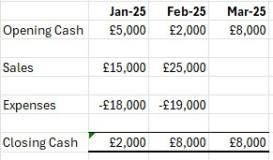
Cashflow
Example –
Green
Garden
Supplies

Slide 17
Example
Working Capital
Calculation
See Spreadsheet

Slide 18



Scenario Planning – What if…?
What happens if customers take longer to pay?
What happens if I have to pay suppliers
earlier?
What happens if I increase stock?

Slide 19


Accounting software
Spreadsheet templates
Finance
Toolkit
Banking tools
Keyfinancialmetrics/Key
Performance Indicators

Slide 20
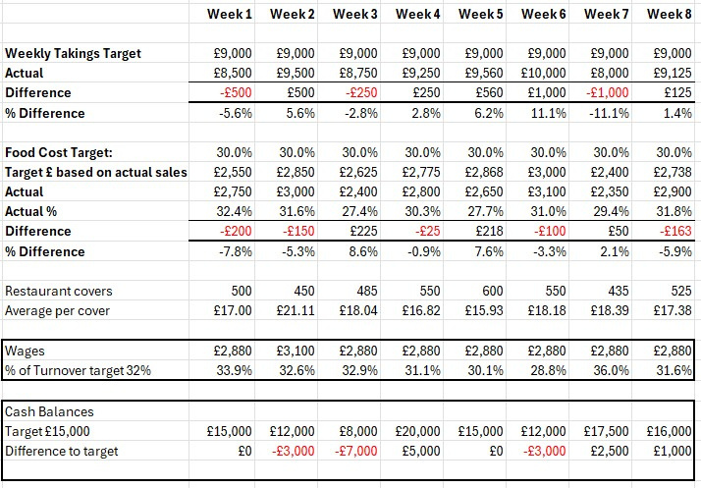
Dashboard and Key Metrics

Slide 21
Gross Profit & Gross Profit Margin
Gross Profit = Sales (Turnover) – Cost of Goods Sold
Gross Profit Margin =
(Gross Profit / Sales) x 100 = %
i.e. how much money you make for every £1 of sale

Slide 22
•
Benchmark
  Industry averages
  Month to month performance
  Annual performance (HMRC–is a flag for fluctuations)
  Key performance indicator
Why is Gross Profit
% Useful
Industry averages
• • • • •
Restaurants – 60-70% Retail clothing – 50-60% Travel agents – 10% Software – 80-90% Manufacturing – 25-50%

