Slide 1


Start-up Essentials
Lateef Badat, Shout Connect, Customer Service Manager.
SFEDI / IOEE Business Advisor / Mentor.
lateef@shoutconnect.co.uk
www.shoutconnect.co.uk

Slide 2


Advisors on call – managing chat. 121’s available follow-up meetings.
Slides to be uploaded to the resources section on GL session
https://www.growthlancashire.co.uk/resources/
Poll – what themes to be covered in next sessions.
Testimonials on Growth Lancashire page - video or written https://www.growthlancashire.co.uk/video-testimonials/

Slide 3


About Me
As a ‘mindset magician’ I help business owners and teams to work smarter and perform better through empowerment, motivation and inspiration.
I provide 1:1 business advice, mentoring, coaching, peer 2 peer support and masterclasses, specialising in digital, creative, media and professional services.
Help you bring your ideas to life and grow your business.
My ethos is focussed on enabling business growth through entrepreneurs’ empowerment, motivation and inspiration.
www.shoutconnect.co.uk

Slide 4

Getting from A to B
By the end of this session, you will understand the key elements of setting up and running a profitable business:
Know your business mission, vision & values
Identify what you want to achieve
Be able to map out your journey
Put in place the steps to trading sustainably

Slide 5

The Ultimate Aim
A to B = Being in Business
To C = Continuing in Business
Be here in a year.
One in two businesses fail in the first year.

Slide 6
Food for thought
What problem do you solve?
Who for?
How?

Slide 7
Key elements to planning and maintaining a business:
Who is your target market
How to undertake market research
Considering if your business is seasonal
Where will you trade from
What are the start-up requirements
The skills and experience you will need to be sustainable
Biggest mistakes made by businesses

Slide 8
Some common mistakes
Lack of Market Research: Target market, customer needs, and competition.
Poor Business Planning: Lack of clear objectives, strategies & financial forecasts.
Insufficient Financial Management: Startup costs, overestimating & revenue projections.
Premature Scaling: Scale too quickly without establishing a solid foundation or testing.
Ineffective Marketing and Branding: Strong brand identity to reach and engage target audience.
Lack of Adaptability: Customer feedback, industry trends, innovate, pivot, and remain competitive.
Poor Team Building and Management: Provide adequate leadership and support.

Slide 9
Business Model Canvass
Download a Business Model Canvass Template (Growth Lancashire, Direct.Gov, Strategyzer or Canva)

Slide 10
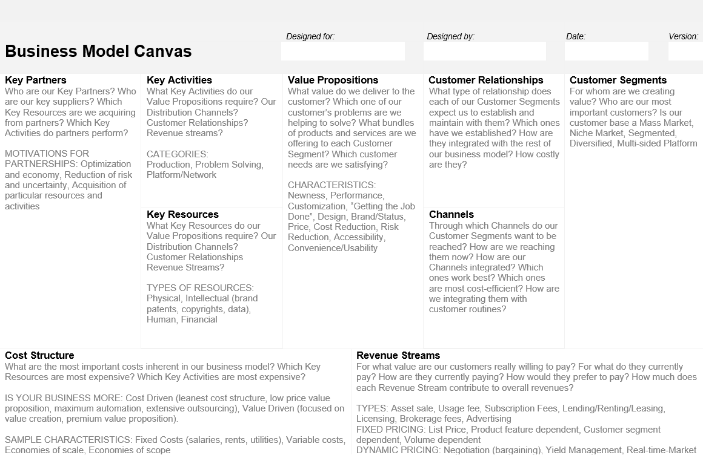

Slide 11
Legal Aspects – Key Elements
What form should your business take including advantages and disadvantages of each legal model. To make an informed choice of your selected business model, understand the differences between:
Sole trader
Partnerships
Private Limited Company
Limited Liability Partnership
Community Interest Company
Limited company with no share capital

Slide 12
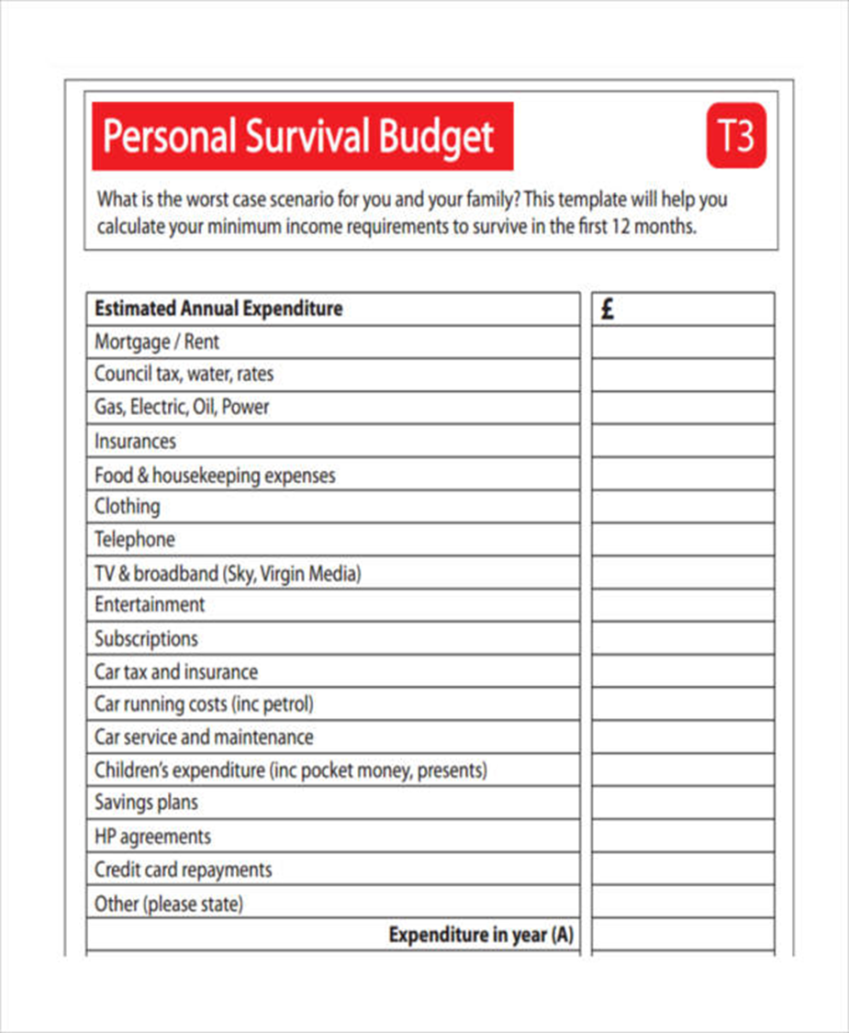
Financial Planning

Slide 13
Financial Planning
The main aim is to develop a realistic financial plan:
Pricing
Do not undervalue your product or service
Consider the cost to produce the product or service
Consider the cost of this time
What are your profit margins?

Slide 14
Financial Planning
Where will the money come from? Start-up funding might include:
Government support for businesses
Start-up loans
Grants
Crowdfunding
Friends and family
Self-financing

Slide 15
Practical Financial Planning
Include a cash flow that estimates the following projections:
Money in: from contracts, customers, direct sales…
Expenditure: all outgoings of the business
Survival income
Wages
The cash flow will show your income projected for the first year.

Slide 16
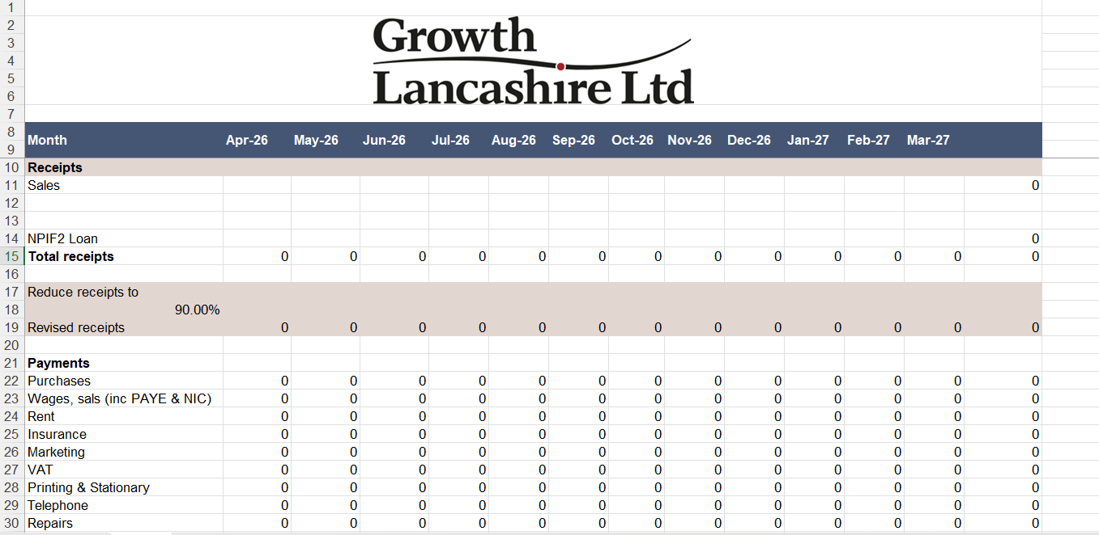
www.shoutconnect.connect.co.uk

Slide 17
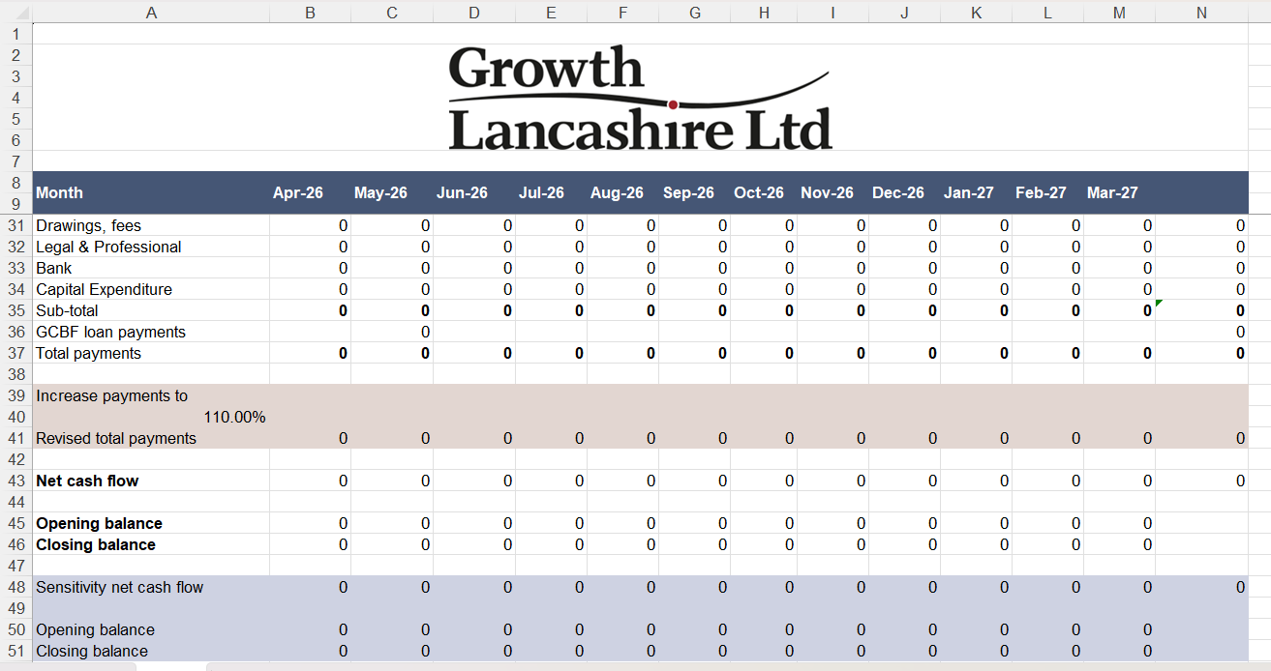

Slide 18
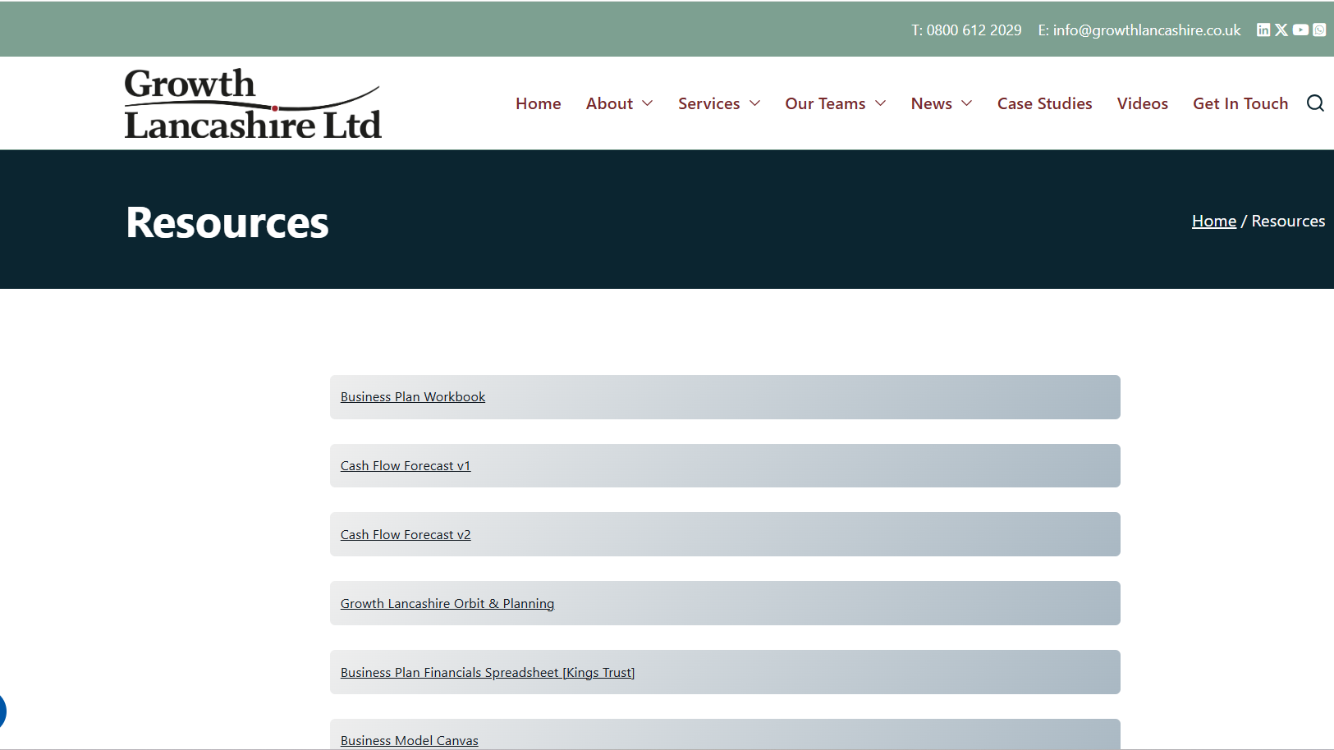

Slide 19
Practical Financial Planning
Pricing checklist
Cost analysis
What is breakeven
Financial essentials
Pricing structures
What margins to do want to achieve
Work out the true cost of each sale

Slide 20
Marketing
Implement high impact marketing to develop your business – tracking
Use branding to deliver your business messages – customer needs
Create opportunities to have positive conversations with potential customers
Business and commercial acumen
Optimise media relations for professional visibility in business
Understand and know how to use social media platforms to benefit your business
How you would improve your business reputation through good PR
Networking
Strategic planning

Slide 21
Business Support Matrix
Skills map: List your skills, experience and business understanding
Market research: List all market research you have already undertaken and what it told you. Why might people buy your product/service?
Target market: Who are you trying to sell your product or service to?
Marketing plan: What do you think will be included in this?

Slide 22
Business Support Matrix
Resources: What do you already own that you might take into the business? I.e. Laptop £300, Tools £200
Fixed and variable costs: List your running costs per month and your monthly outgoings
What do you need to start? List all of your start-up capital items required and other set-up costs
Sales: What will you sell in months 1-3, months 4-6, months 7-12?

Slide 23
Business Support Matrix
Suppliers: Where do you intend to buy stock? Map out your services
Insurance: What insurance do you think you need? Public liability, employer's liability, professional indemnity
USP: What makes you different? Better that your competitors? Why buy me?
Payment terms: What are you terms and conditions? Contracts? Invoicing mechanisms

Slide 24
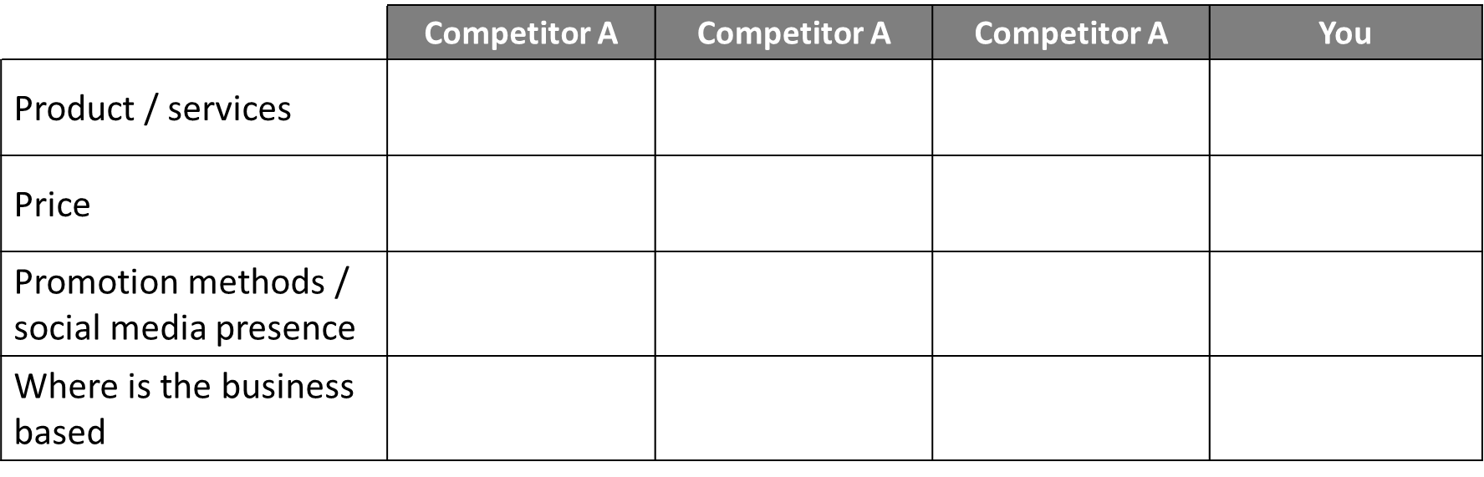
Who else does what you do?

Slide 25
Questions
Testimonials on Growth Lancashire page - video or written https://www.growthlancashire.co.uk/video-testimonials/

Slide 26
Lateef Badat Shout Connect SFEDI / IOEE Business Advisor / Mentor lateef@shoutconnect.co.uk https://uk.linkedin.com/in/lateefbadat

