Slide 1
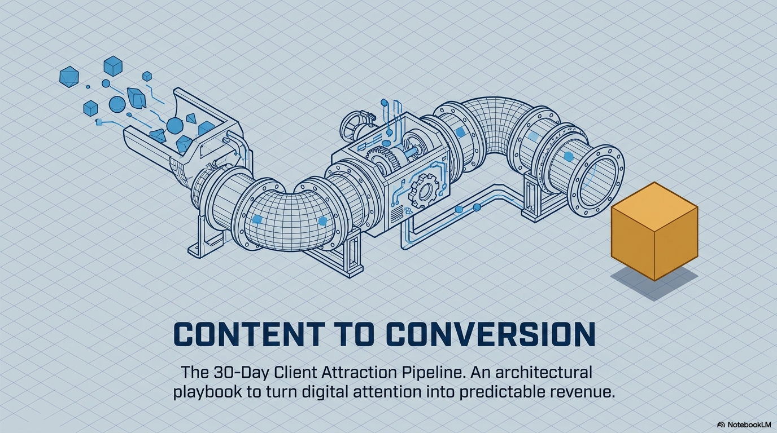
Notes:
Today we are looking at taking your valuable content and making it do the sales

Slide 2
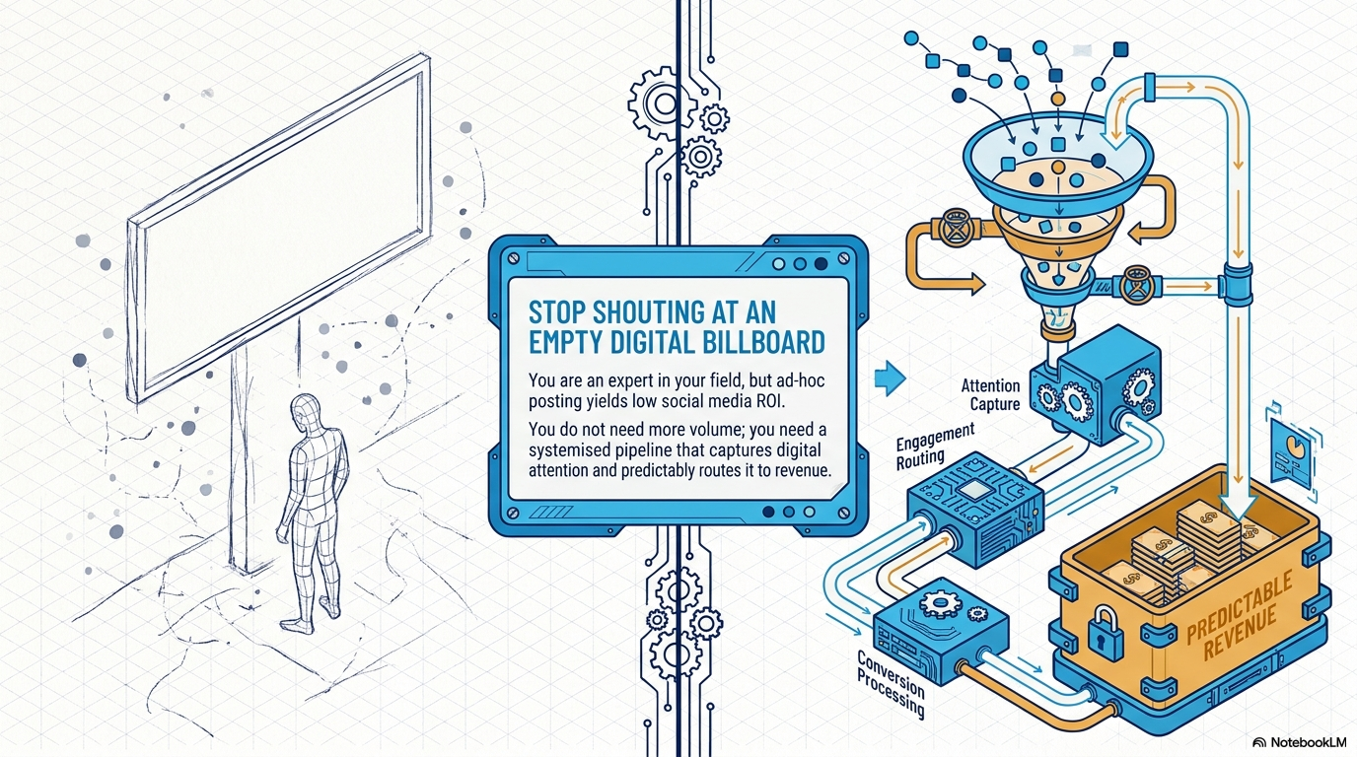
Notes:
We are going to put a process in place that fills your funnel and converts to sales - so we get the attention, engage, convert and turn in to revenue.

Slide 3
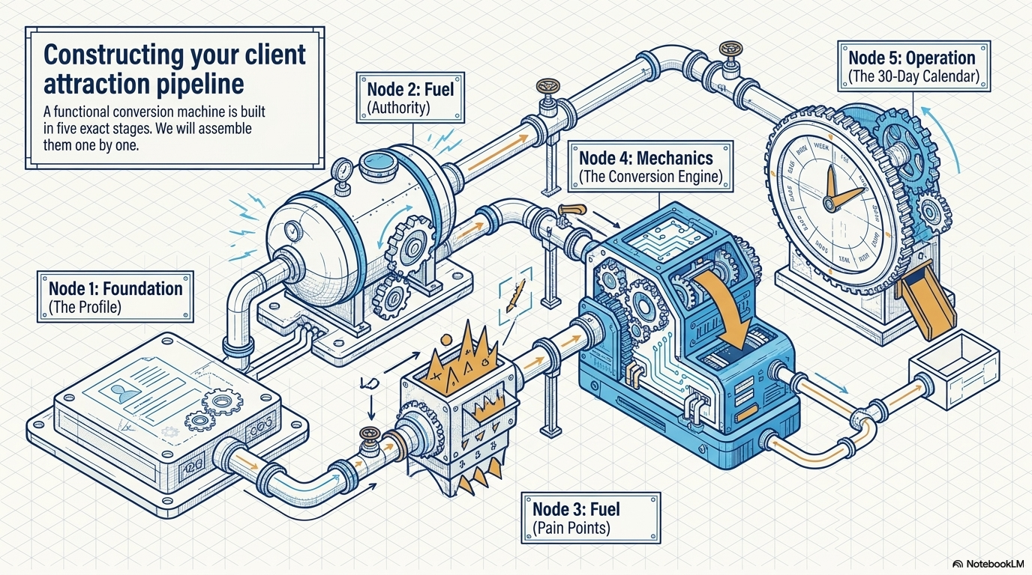
Notes:
So we start with the profile, how you become and authority, what pain points you have, how to convert and the 30 day calendar.

Slide 4
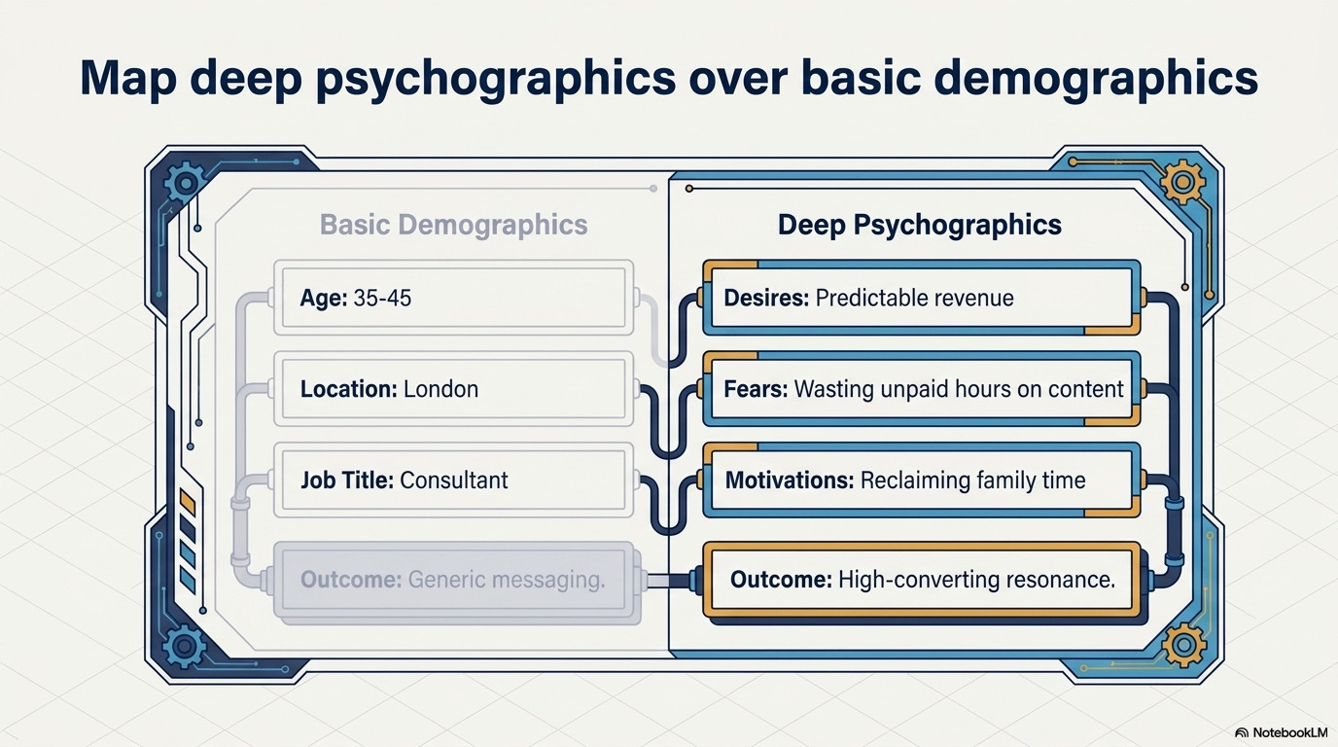
Notes:
But lets start with who your ideal customer is - work through demographics etc

Slide 5
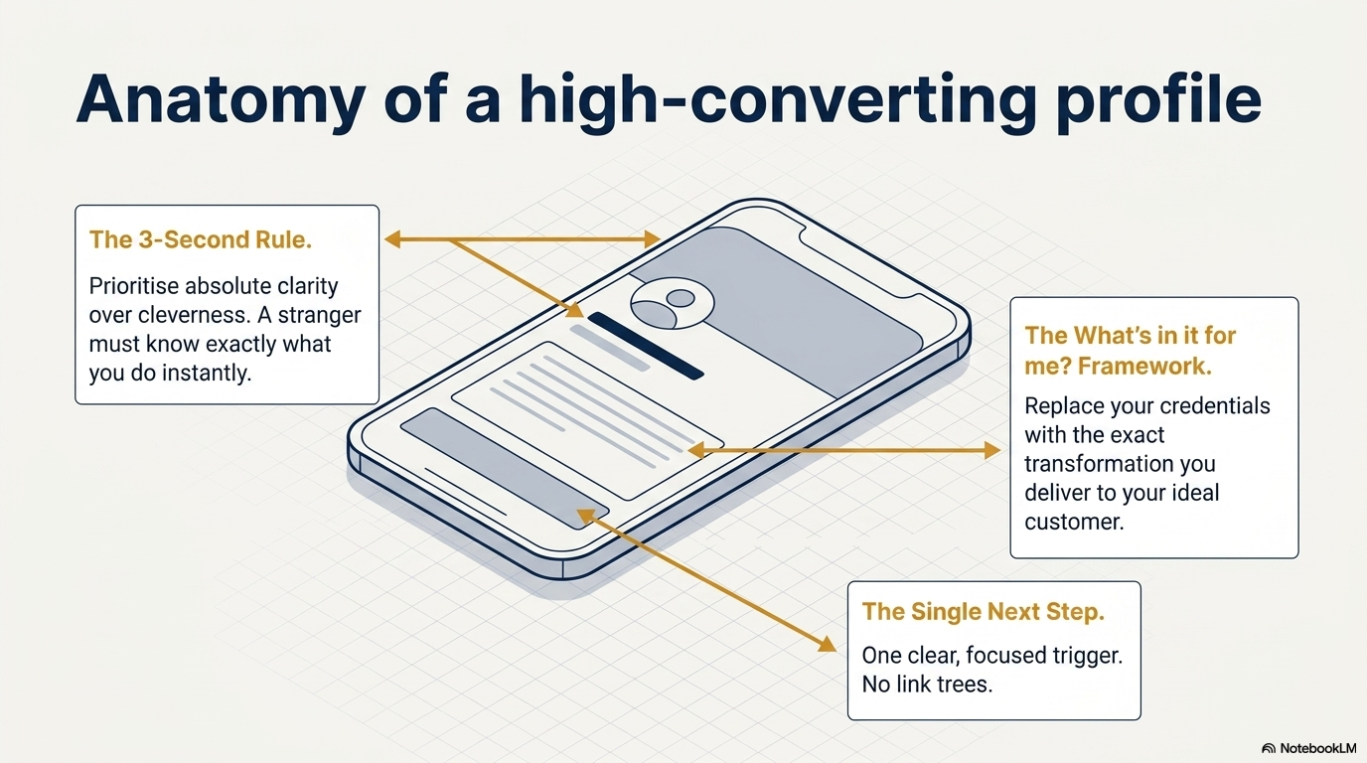
Notes:
pick a profile and lets all pick it apart - go round the room.

Slide 6
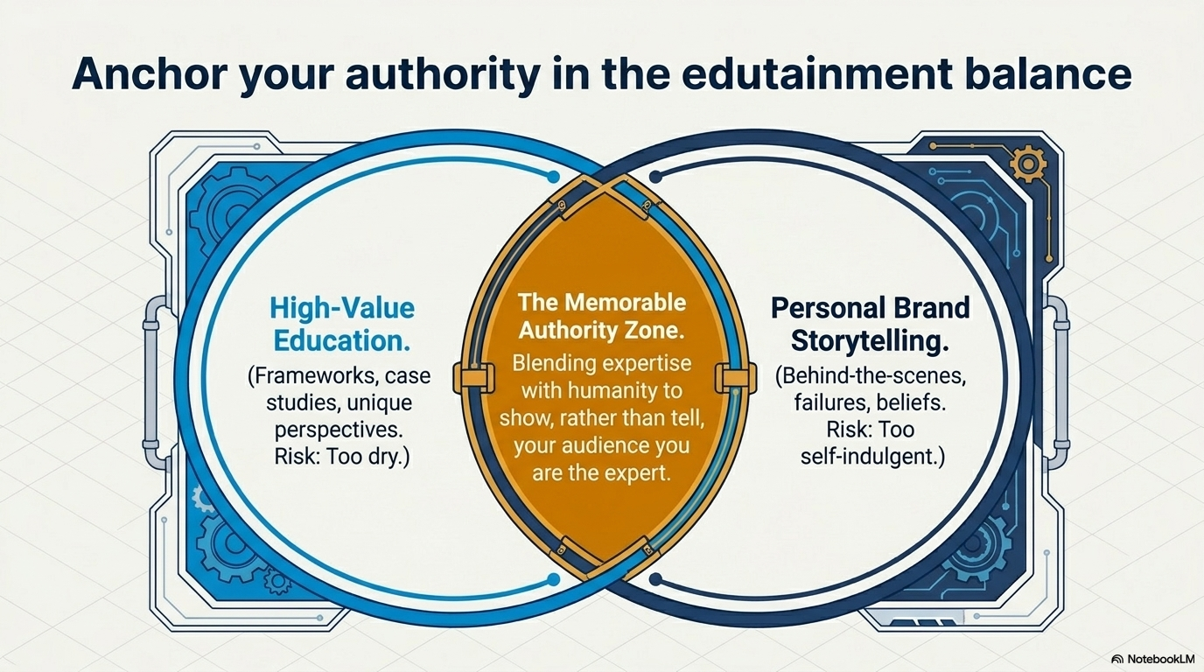
Notes:
Lets look at your authority - lets aim for the memorable.

Slide 7
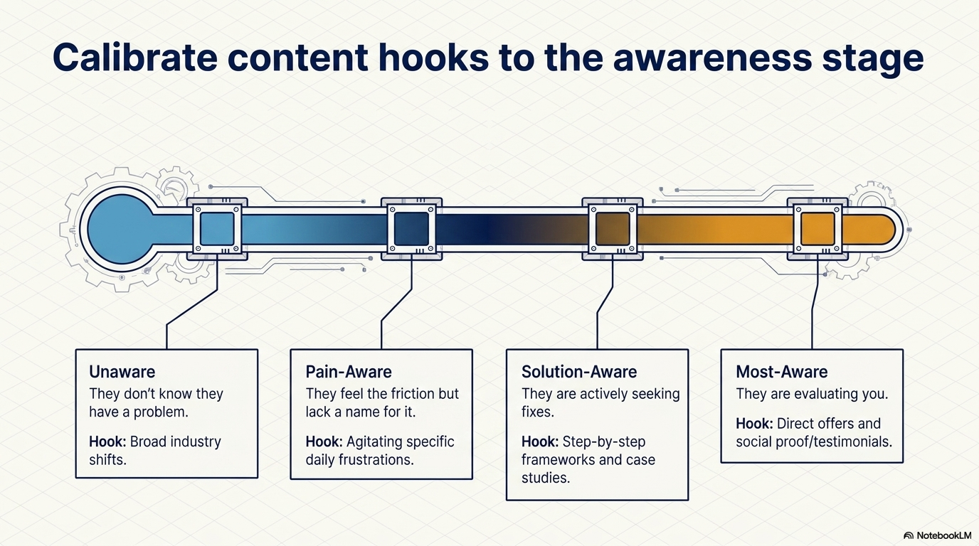
Notes:
So lets have hooks for the different stages - no one will work for all stages

Slide 8
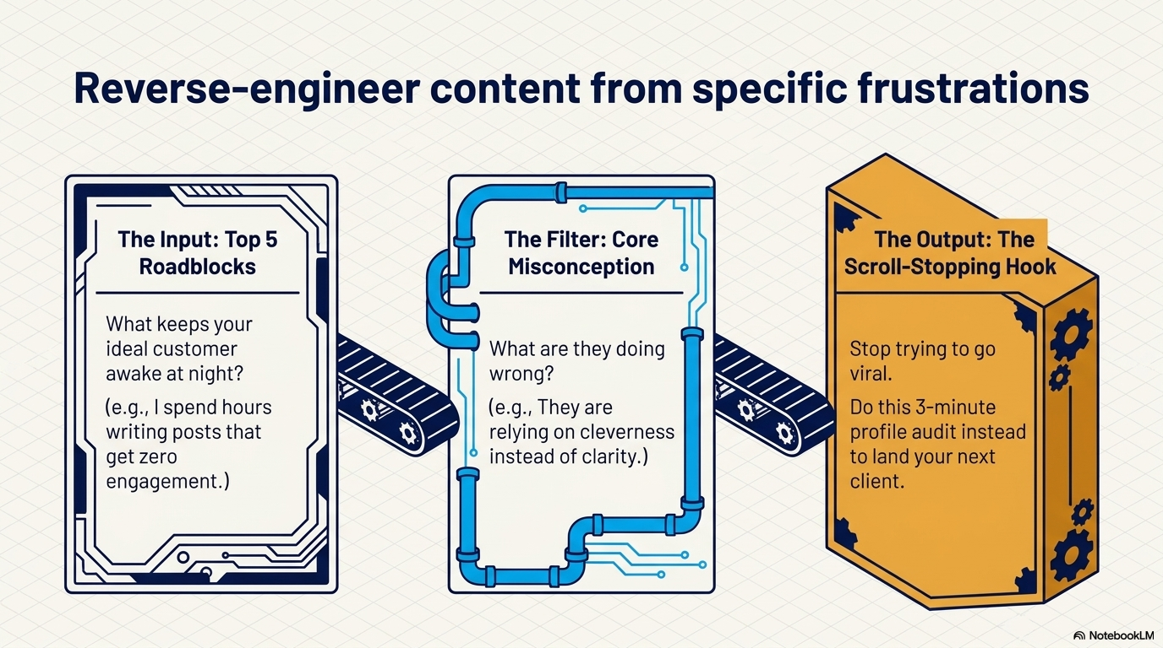
Notes:
Lets work on moving from input to output - so work on all to get there spend time on 5 roadblocks

Slide 9
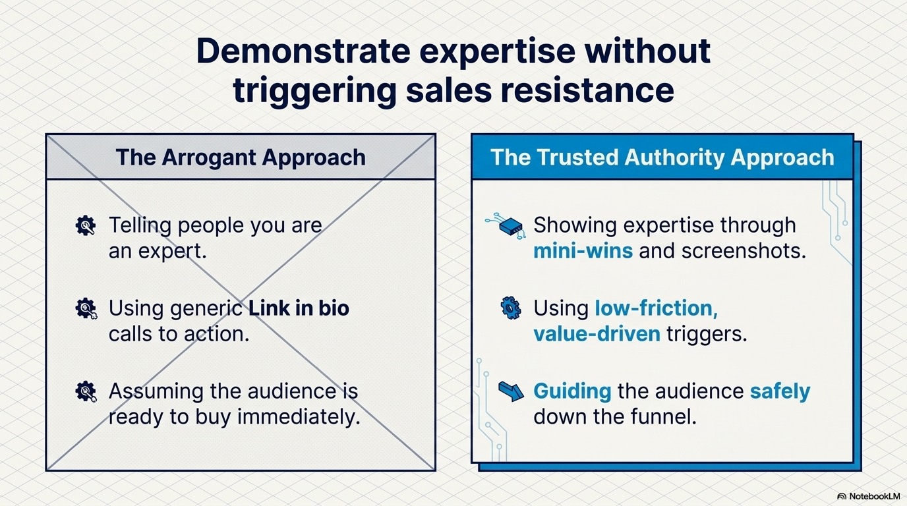
Notes:
work on the authority - we've worked on profile, pain points, hooks and now lets place the business as the font of knowledge.

Slide 10
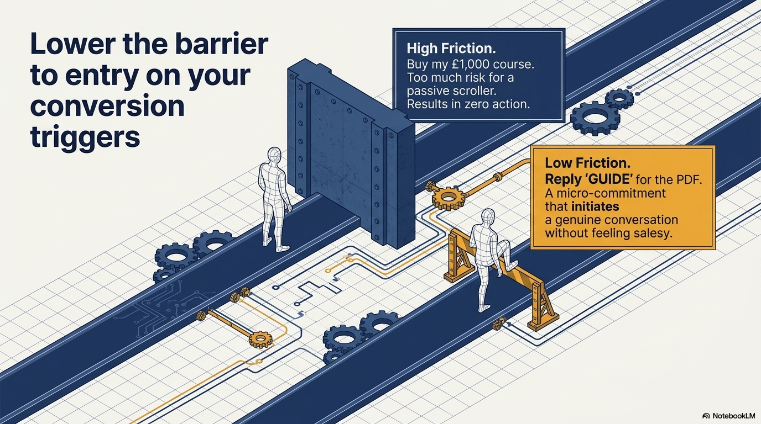
Notes:
Conversion - stop scaring them away - don't go in with the top hard sell - offer them something to start the conversation

Slide 11
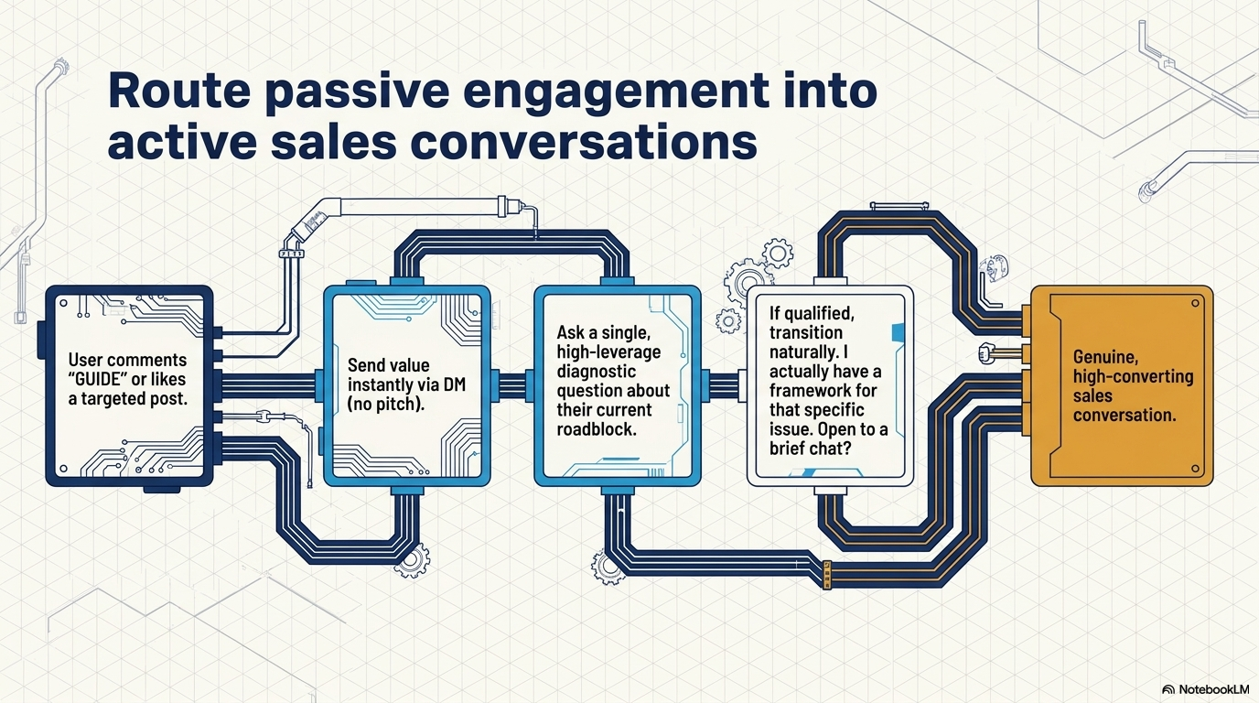
Notes:
so you have posted up something on a pain point - an article or guide - they like it or comment, send them the link to the guide - no pitch - just helpful - they will say thanks - then go back and ask about roadblock if they answer say hey how about a chat - take it off socials and convert.

Slide 12
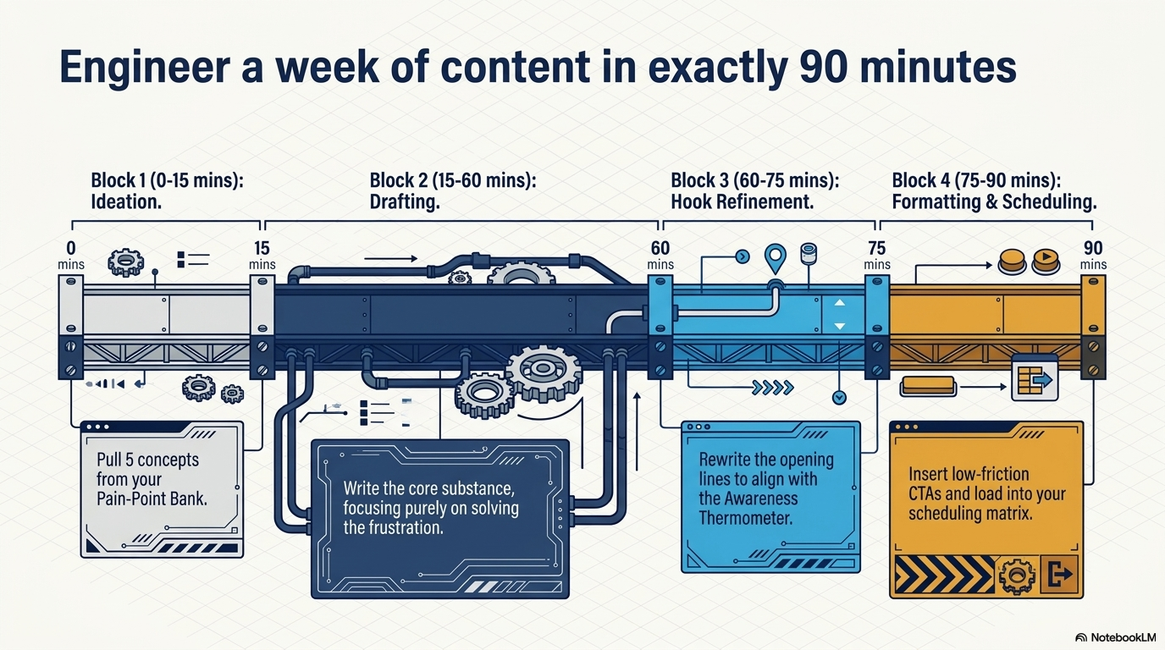

Slide 13
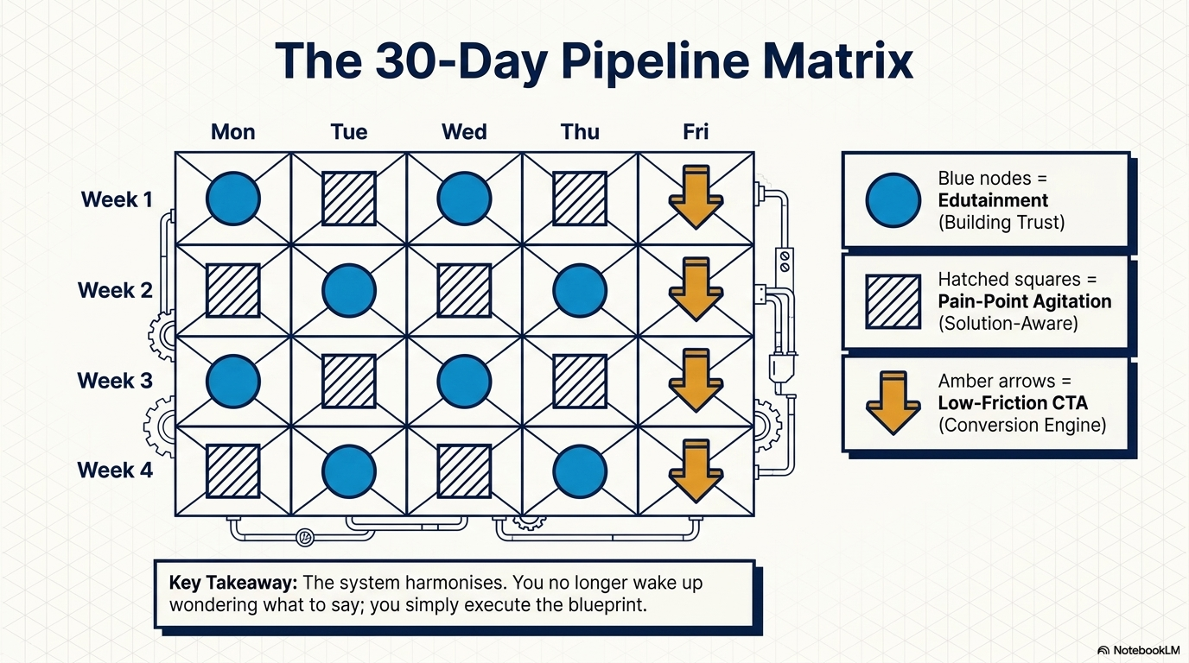

Slide 14
