Slide 1
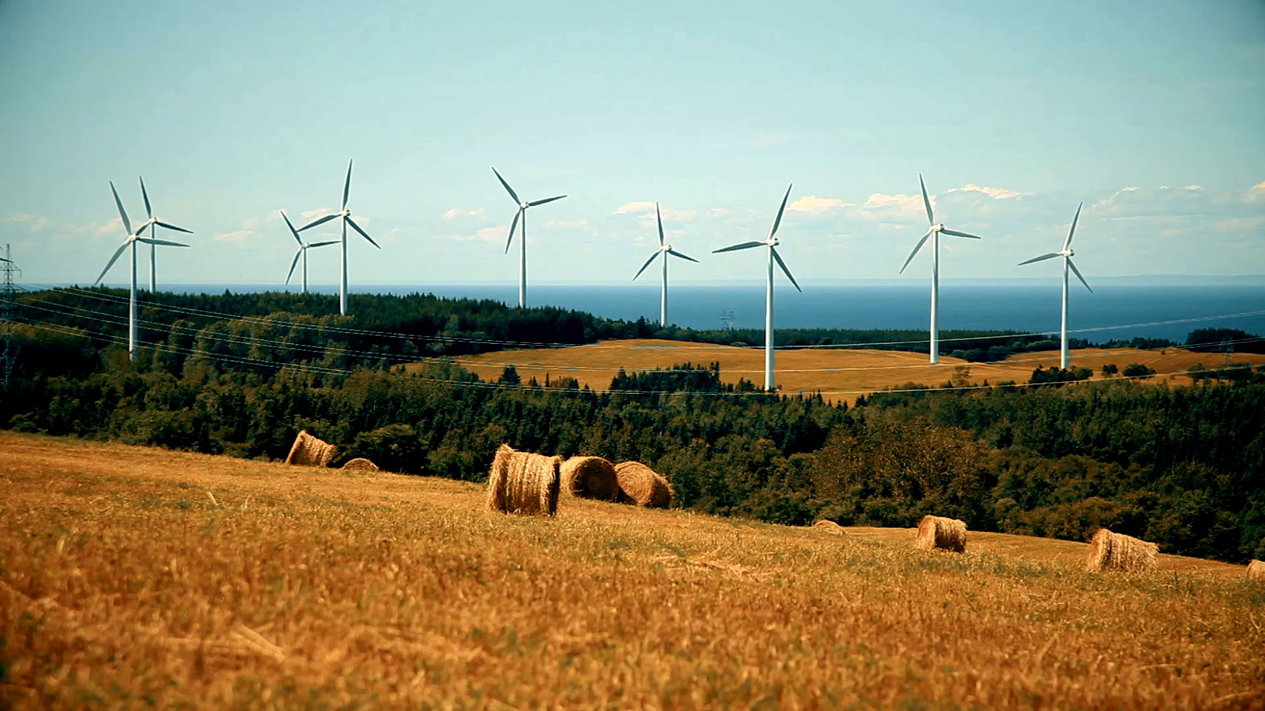
Growth Session
Create More Time, Focus and Capacity

Slide 2
Signpost
FINAL GROWTH Session
Interactive & Facilitated
Bespoke to You
Peer Learning

Slide 3
What is your biggest productivity challenge right now?
Who are you?
Why are you here today?
What purpose does your business serve?
What is your biggest capacity challenge?

Slide 4
Energy for Impact know where your energy comes from and design your week around it
What gives you energy?
What drains you?
When are you at your best?
What work creates the most impact for your business?
Are you doing high-impact work at low-energy times?

Slide 5
Where is your time really going?
What are you doing that doesn’t need to be done by you, done now, or done that way?
What’s one repeating task that currently eats your time?

Slide 6
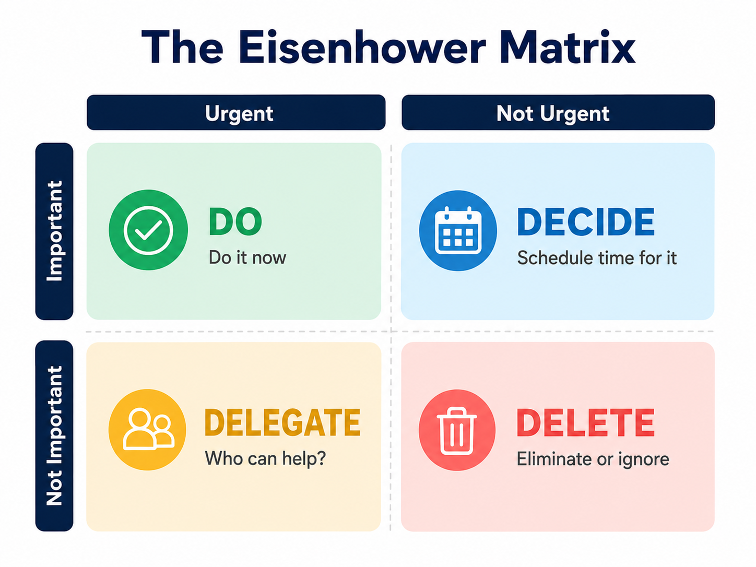

Slide 7

Break

Slide 8

Tools, habits and systems
GTD / Getting Things Done
Capture
notebook, app
Clarify When
2-minute Rule
Organise
Projects & Next Actions
Reflect
Weekly review
Engage
Tools, Time, Energy, Priority

Slide 9
Tools, habits and systems
Pomodoro
25 minutes focused work
5-minute break
Repeat

Slide 10
Calendar time blocking
Start with your non-negotiables
1
Identify your high-value business activities
2
Match tasks to your energy
3
Protect Quadrant 2 time
Important but not urgent growth work.
4
Batch similar tasks
5
Add buffer time
6
Review weekly
7

Slide 11
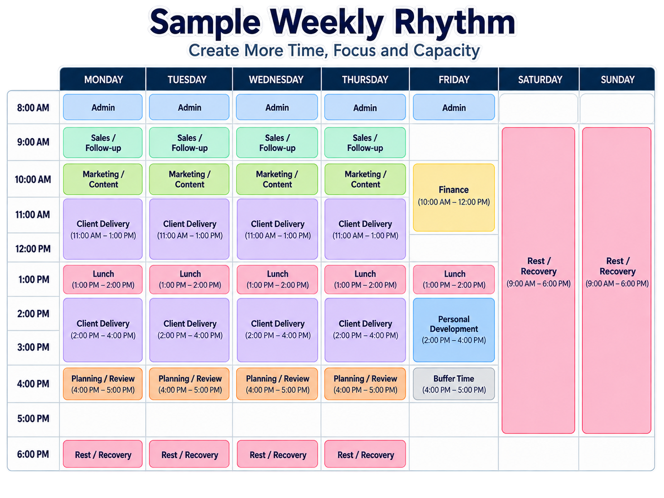
Tools, habits and systems
Design your weekly rhythm
Planning/review
Admin
Client delivery
Sales/follow-up
Marketing/content
Finance
Learning/development
Rest/recovery
Buffer time

Slide 12
Actions and Accountability
My main productivity challenge is…
One action I will take in the next 7 days is…
One action I will take in the next 30 days is…
The person who will hold me accountable is…
The one thing I will stop is…
The One thing I will protect is…

Slide 13
Thank You!
A journey of a thousand miles begins with a single step
Feedback
Next EVENT
Follow up 121 or Clinics
Other support – Digital Boost

